Slide 1

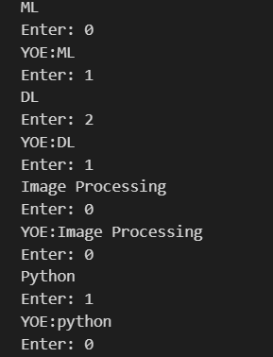
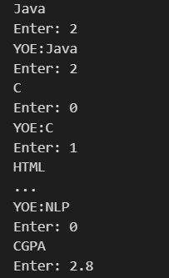
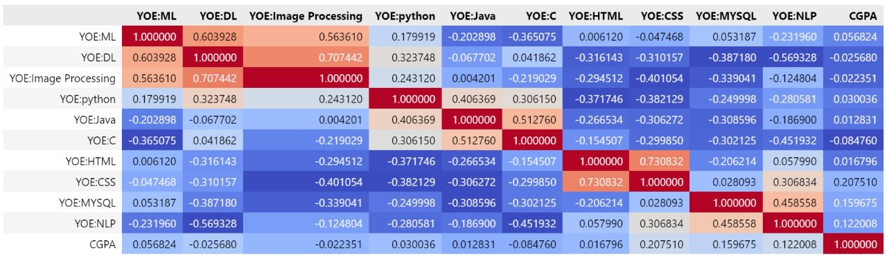
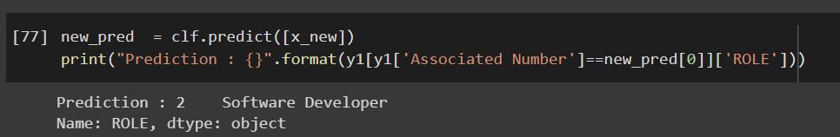
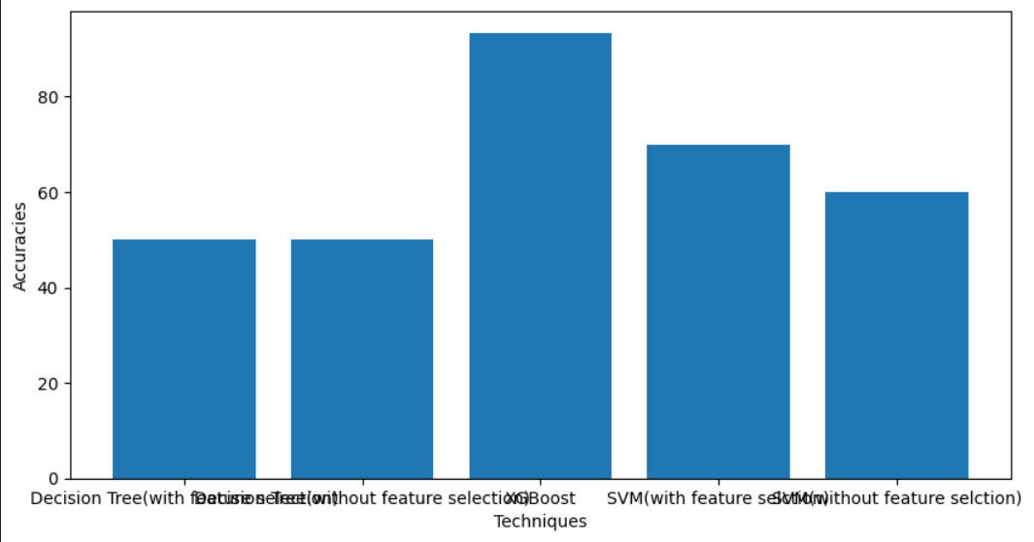
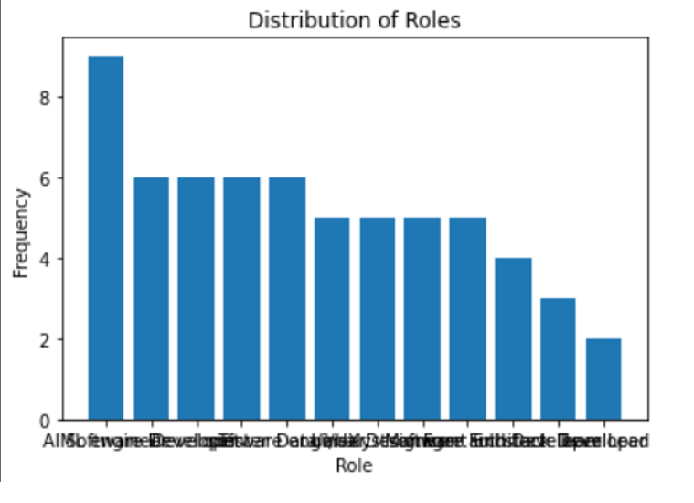
CAREER GUIDANCE SYSTEM Srinath-20WU0101031 Hotragn-20WU0101030
Overview
Career guidance system that can help students choose the right paths for future emerging technologies through their existing level of knowledge, interests, and available sectors to improvise in the future by the time the students reach career level, based on past people who succeeded in choosing the same path, thereby providing the best suggestion through ML.
Problem Objectives
Data set
A real time dataset with respect to skillset, years of experience, and roles
The data set consists of 12 classes and 22 attributes
Output
Choosing a Career path varied with personal skills with respect to years_of_experience
Increasing the efficiency of the dataset
To develop a feasible system that will take input parameters and give a result
correlation
Outcomes
Based on the skillset and years for each skill, what might their career role be assigned as?
Web Page which can suggest the career path
Results
These graphs represents feature selection w.r.t classifiers
and data w.r.t each attribute
Novelty
Overcome existing challenges of the dataset
Based on the past people review who succeeded in choosing the same path and thereby providing the best suggestion through prediction
Reference
Wulansari, R. E., Sakti, R. H., Ambiyar, A., Giatman, M., Syah, N., & Wakhinuddin, W. (2022). Expert System For Career Early Determination Based On Howard Gardner's Multiple Intelligence. Journal of Applied Engineering and Technological Science (JAETS), 3(2), 67-76.

